Slide 1
Mendel’s Work
Mr. Jones
Standard 7.2.d Students know plant and animal cells contain many thousands of different genes and typically have two copies of every gene.

Slide 2
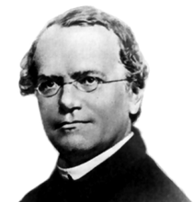
Who is Mendel?
A priest who lived in the mid-nineteenth century
Tended the monastery's garden
Created plant hybrids in his garden and discovered heredity

Slide 3
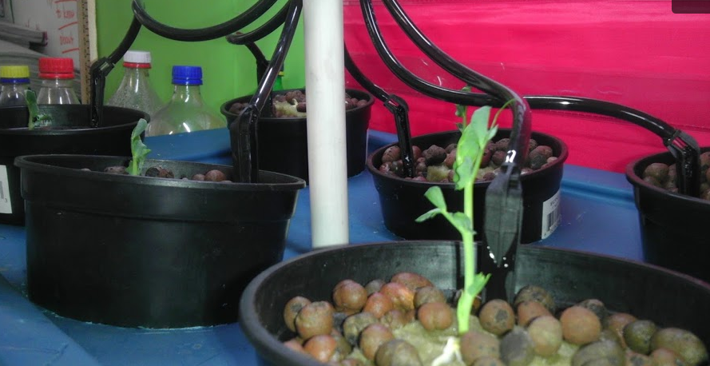
What is Heredity?
Heredity
The passing of physical characteristics from parents to offspring
Pea Plants
Mendel wondered why pea plants had different characteristics
Each different characteristic is called a trait

Slide 4
Genetics
Mendel observed that the pea plants’ traits were often similar to those of their parents
Sometimes there was variation
Variation: The pea plants had different traits from those of their parents
Mendel experimented with thousands of pea plants
Mendel’s experiments led to the foundation of:
Genetics
The scientific study of heredity

Slide 5
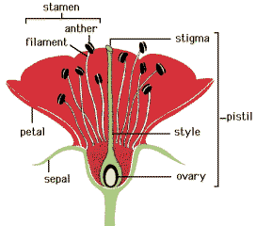
Medel’s Experiments
Figure 1

Slide 6
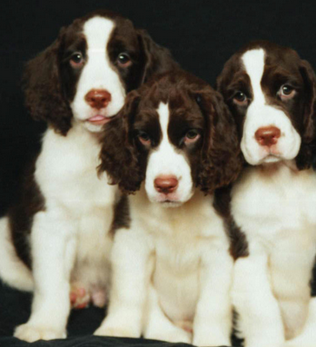
Purebred vs. hybrid
Purebred
An organism is the offspring of many generations that have the same trait (one type of allele)
Example:
Hybrid
An organism that has two different alleles for a trait

Slide 7
Genes & Alleles
Gene
Factors that control a trait
Alleles
The different forms of a gene
Mendel observed
Each pea plant inherits 2 alleles from its parents
One allele from the egg, one from the sperm
A pea plant may inherit two alleles for tall stems, two alleles for short stems, or one of each

Slide 8
Dominant Allele vs. Recessive Allele
An organism’s traits are determined by the alleles it inherits from its parents
Some alleles are dominant, while other alleles are recessive
Dominant allele
One whose trait will always show up in the organism when the allele is present
Recessive allele
A hidden allele whenever the dominant allele is present
Will only show up whenever a dominant allele is not present

Slide 9
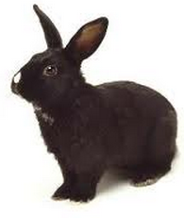
Put Into Practice
Black Fur (Dominant) White Fur (Recessive)
Question: Does this rabbit possess a dominant allele?
Answer: Yes, the rabbit does possess a dominant allele because it has black fur

Slide 10
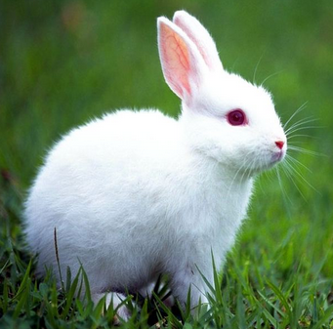
Put Into Practice
Black Fur (Dominant) White Fur (Recessive)
Question: Does this rabbit possess a dominant allele?
Answer: No, the rabbit does not contain a dominate allele because it does not have black fur

Slide 11
Your Assignment
Using the punnett squares find the alleles that would be passed from parent to offspring
1)
T
T
2)
T
t
3)
T
t
T
t
T
T
t
t
T= Dominant Tall t= Recessive Short
Dominant always gets written in capital and gets placed before the recessive trait

