Slide 1
Cell Organelles
Mr. Jones
1/7/13
CA Content Standard: 5.a
Students know plants and animals have levels of organization for structure and function of cells

Slide 2
Welcome Back
I hope you had a great break
Any stories from the break?
Any more science camp letters?

Slide 3
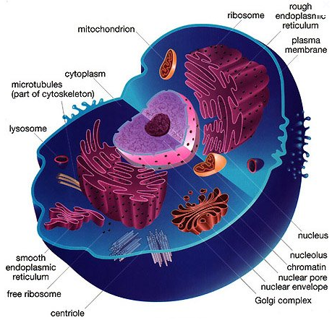
What is a cell?
The basic unit of structure and function in living things

Slide 4
Organization of a Cell
Just as the human body is made of organs, so is a living cell
Organs in a cell are known as “organelles”
A tiny cell structure that carries out a specific function within the cell

Slide 5
Nucleus
The nucleus of the cell is the cell’s control center, directing all of the cell’s activities

Slide 6
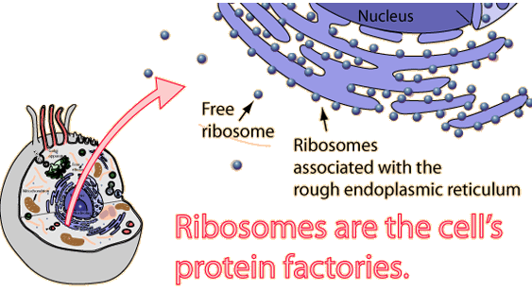
Ribosomes
Small organelles where protein is produced

Slide 7
Mitochondria
The mitochondria release most of the cell’s energy
Known as the cell’s “powerhouse” because they convert energy in food molecules to energy the cell can use to carry out its function

Slide 8
Endoplasmic Reticulum
A maze of passageways that help form proteins and other materials
They also carry material throughout the cell

Slide 9
Golgi body
Organelles that transport materials
Also known as the cell’s “mail room”
Receive proteins and other newly formed materials from the endoplasmic reticulum
Distribute the package and materials to other parts of the cell
Also receive materials outside the cell

Slide 10
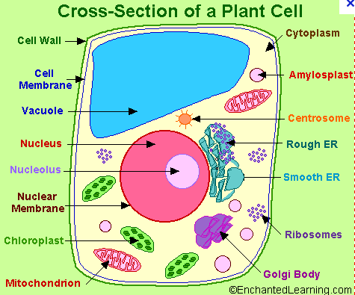
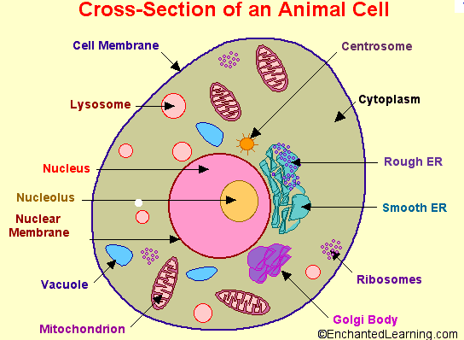
Vacuoles
Storage areas of cells
Plants have one large central vacuole
Animal cells do not have central vacuoles
Plant Cell
Animal Cell

Slide 11
Lysosomes
Break down large food particles into smaller ones
Also break down old cell parts and release the substances so they can be used again (recycle)
Are the janitors of the cell

