Slide 1
Cell Structure and Vocabulary
1/8/13
Standard 7.1 All living organisms are composed of cells, from just one to many trillions, whose details usually are visible through a microscope

Slide 2
Review
What is a cell?
The basic units of structure and function in living things
What are the organelles of a cell?
Nucleus
Mitochondria
Endoplasmic Reticulum
Ribosomes
Golgi body
Vacuole
Lysosomes
Chloroplasts (Plants)
Cytoplasm

Slide 3
Chloroplasts
Chloroplasts capture energy from sunlight and use it to produce food
Think Photosynthesis
Chloroplasts are only located in plants and plankton

Slide 4
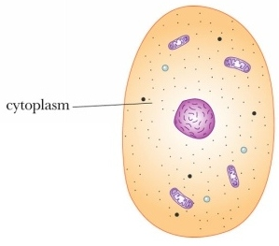
Cytoplasm
The region between the cell membrane and the nucleus
Cytoplasm is constantly moving

Slide 5
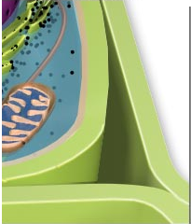
Cell Wall
Is a rigid layer of nonliving material that surrounds the cell
Is only found in plants and some other organisms
A cell wall helps protect and support the cell

Slide 6
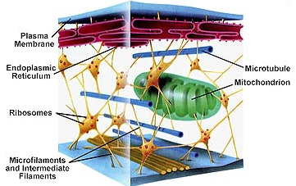
Cytoskeleton
Animal cells and many single celled organisms do not have cell walls, but a cytoskeleton.
A protein “framework”
A cytoskeleton gives the cell it’s shape

Slide 7
Cell Membrane
The outside boundary that separates the cell from its environment
In plant cells, this is located just inside the cell wall
In animal cells, the cell membrane forms the outside boundary that separates the cell from its environment
The cell membrane controls what substances come into and out of a cell ←Important, will be on test

Slide 8
Cell Theory
All living things are composed (made) of cells
Cells are the basic units of structure and function in living things
All cells are produced from other cells

