Slide 1
Chemical Compounds in Cells
Mr. Jones
1/22/13
S 7.1.a Students know cells function similarly in all living organisms

Slide 2
Key Terms
Element
Compound
Carbohydrate
Lipid
Protein
Amino Acid
Enzyme
Nucleic Acid
DNA
RNA

Slide 3
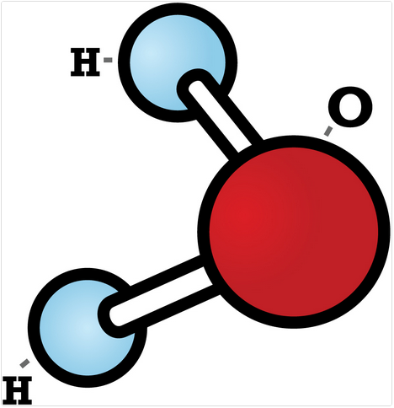
Element
Element
Any substance that cannot be broken down into simpler substances
Atom
The smallest unit of an element

Slide 4
Compounds
Compound
Two or more elements combine chemically
Example:
Water
Formed with two hydrogen and one oxygen
Most chemical reactions within cells could not take place without water

Slide 5
Compound or Not?
Carbon Dioxide
Salt
Water
Hydrogen
Nitrogen
Compound (CO2)
Compound (NaCl)
Compound (H2O)
Not a Compound
Not a Compound

Slide 6
Inorganic and Organic Compounds
Inorganic Compounds
Do not contain the element carbon
Organic Compounds
Compounds that contain the element carbon

Slide 7
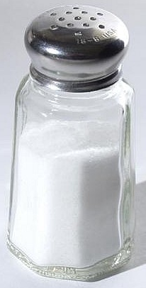
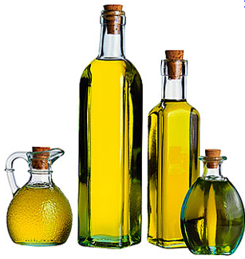
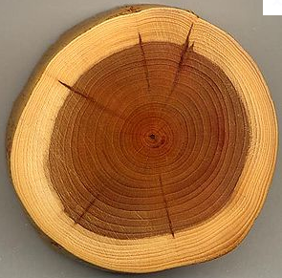
Organic or Inorganic
1)
2)
3)
Inorganic
Organic
Organic

Slide 8
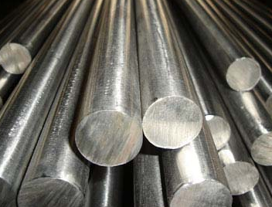
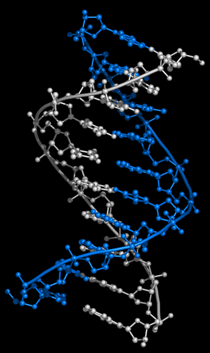
Organic or Inorganic
4)
5)
Inorganic
Organic

Slide 9
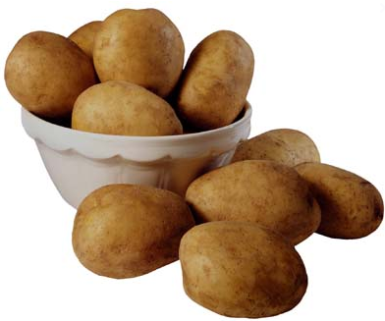
Carbohydrate
Carbohydrate
An energy-rich organic compound made of the elements:
Carbon
Hydrogen
Oxygen
Examples
Sugar and Starches
Provide energy and other important components to the cell

Slide 10
Lipids
Lipids
Energy-rich organic compounds made of carbon, hydrogen, and oxygen
Contain more energy than carbohydrates
Cells use lipids to store unused energy for later
Fats
Oils
Waxes

Slide 11
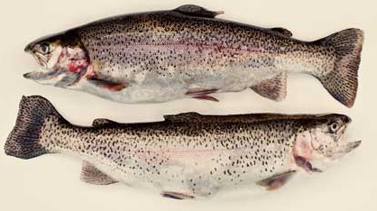
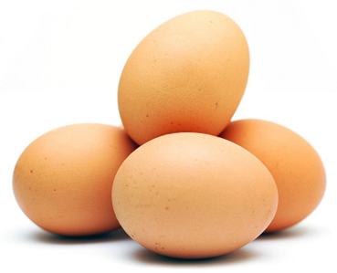
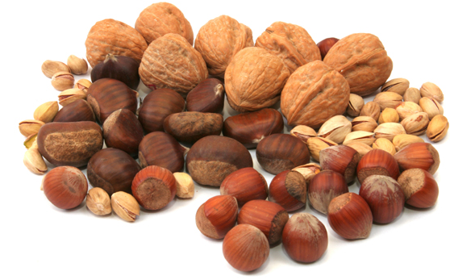
Proteins
Proteins
Large organic molecules made of
Carbon
Hydrogen
Oxygen
Nitrogen
Some cases Sulfur

Slide 12
Amino Acids & Enzymes
Amino Acids
The smaller molecules that make up proteins
20 common amino acids
Can combine to form thousands of different proteins
Enzymes
A type of protein that speeds up a chemical reaction in a living thing

Slide 13
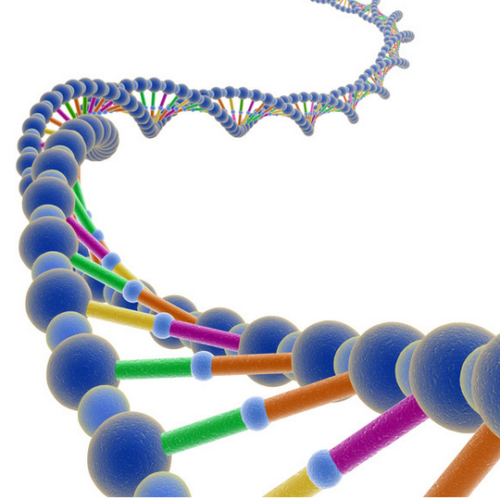
Nucleic Acids
Nucleic Acids
Contain the instructions that cells need to carry out all the functions of life (2 types)
DNA
Deoxyribonucleic Acid (DNA)
Genetic material that carries information about an organism and is passed from parent to offspring
Information directs all of the cell’s functions

Slide 14
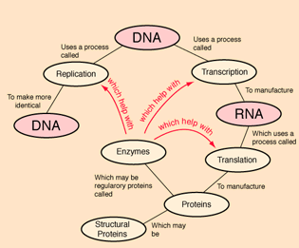
Ribonucleic Acid (RNA)
Ribonucleic Acid (RNA)
Plays an important role in the production of proteins

