Slide 1
Mr. Jones
11/29/12
Retrieved from http://www.exploratorium.edu/learning_studio/cow_eye/coweye.pdf

Slide 2
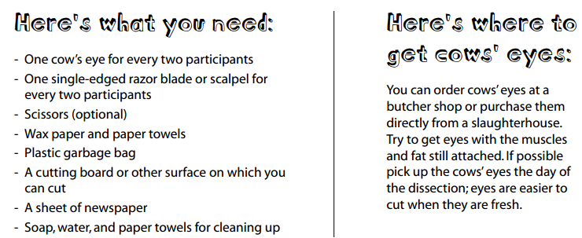
Cow Eye Dissection

Slide 3
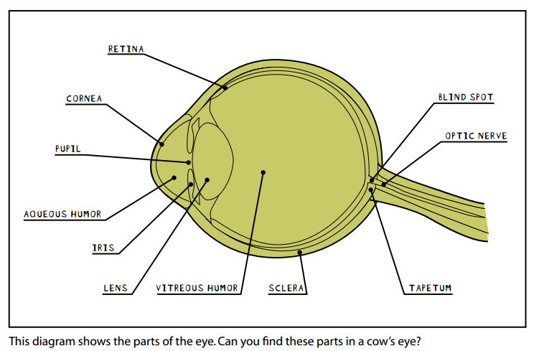
Parts of a Cow’s Eye

Slide 4
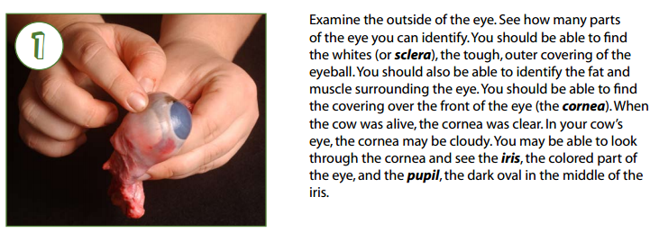
Step 1

Slide 5
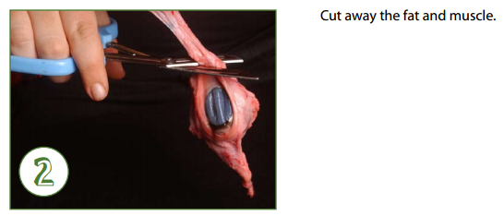
Step 2

Slide 6
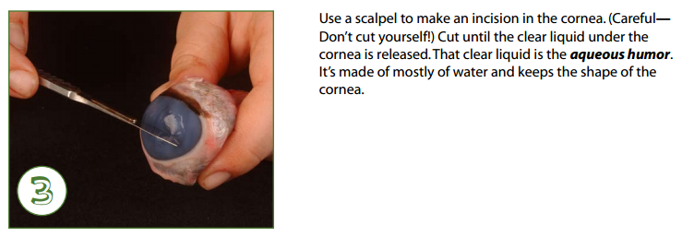
Step 3

Slide 7
Step 4

Slide 8
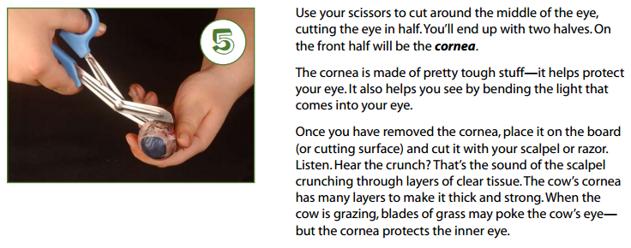
Step 5

Slide 9
Step 6

Slide 10
Step 7

Slide 11
Step 8

Slide 12
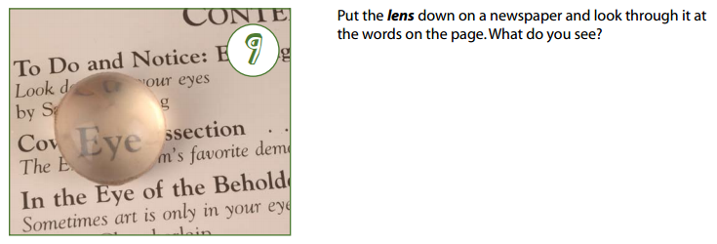
Step 9

Slide 13
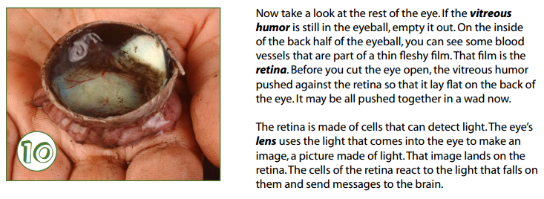
Step 10

Slide 14
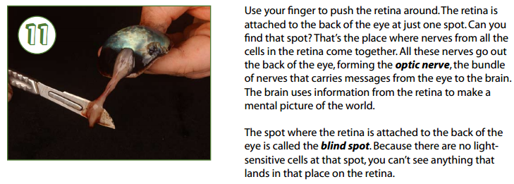
Step 11

Slide 15
Step 12

Slide 16
Step 13

Slide 17
Clean Up
Dispose of the cow eye parts in the trash
Rinse off
Scapula
Scissors
Styrofoam mat
Place items on Styrofoam mat in the middle of the table for the next group
Wash your hands

Slide 18
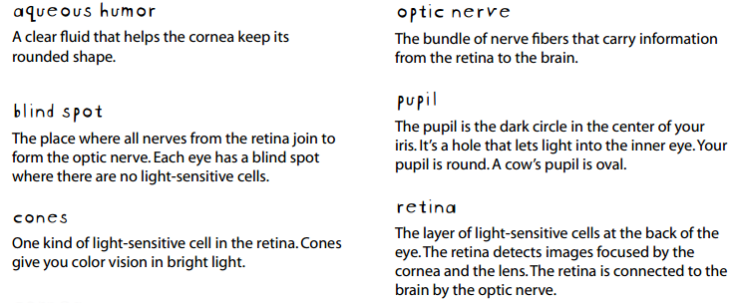
Key Vocabulary

Slide 19
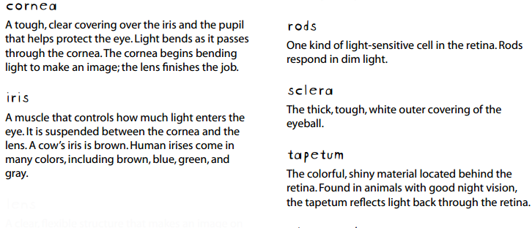
Key Vocabulary Cont.

Slide 20
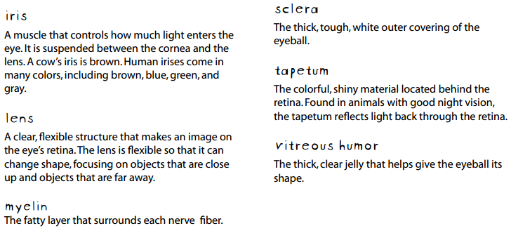
Key Vocabulary Cont.

