Slide 1
Classification Using a Dichotomous Key
Mr. Jones
6/14/2013
Common Core RST6-8.3 Follow precisely a multistep procedure when carrying out experiments.
CA Science Standard: 3d. Students know how to construct a simple branching diagram to classify living
groups of organisms by shared derived characteristics

Slide 2
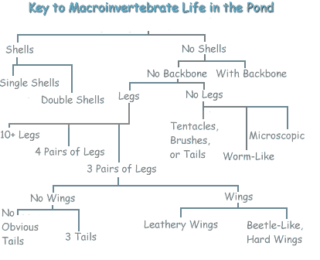
What is a dichotomous key?
A dichotomous key
Is a tool that allows the user to determine the identity of items in the natural world, such as trees, wildflowers, and mammals.

Slide 3
Warm Up Objective
Students will use the dichotomous key to figure out the scientific binomial name for each item.
Key vocabulary
Binomial: a two term name for a species
Classification: a method of scientific taxonomy used to group and categorize organisms into groups

Slide 4
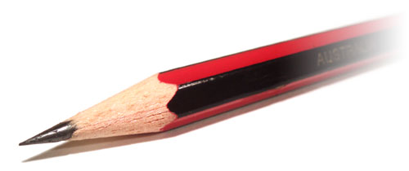
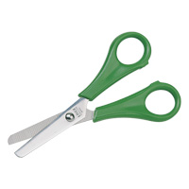
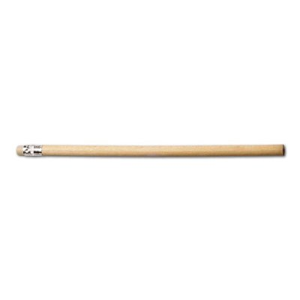
Small Paper Clip
Sharpened Pencil
Large Paper Clip
Paper Fastener
Ruler
Pen Lid
Scissors
Unsharpened Pencil
Splint
Eraser
Calculator

Slide 5
Time to Check

Slide 6
Itsy Bitsy
Scratchy
Super Duper
Clipper
Wadget
Thingy
Widget
Scritchy
Screecher
Oopsey
Gadget

Slide 7
Activity Objective
Use the dichotomous key to correctly identify the amphibians and reptiles
Classify the amphibians and reptiles based on similar traits

Slide 8
Identifying Newly Discovered Amphibians
No
Yes
Does it have legs?
No
Does it have a tail?
Sagalla caecilian
Yes
Does it have an elongated nose?
Yes
No
Montseny Brook newt
Is the skin rough and warty?
Does it have very large eyes in relation to its head?
Yes
Yes
No
No
Does it have a stout, rounded body and short legs?
Mr Burns beaked toad
Long-nosed treefrog
Does it have webbed feet and large toepads?
Yes
No
No
Yes
Microhylid frog
Thampi’s torrent frog
Does it have stripes?
Yes
No
Rabb’s fringe-limbed treefrog
Tiger’s treefrog
Raorchestes

Slide 9
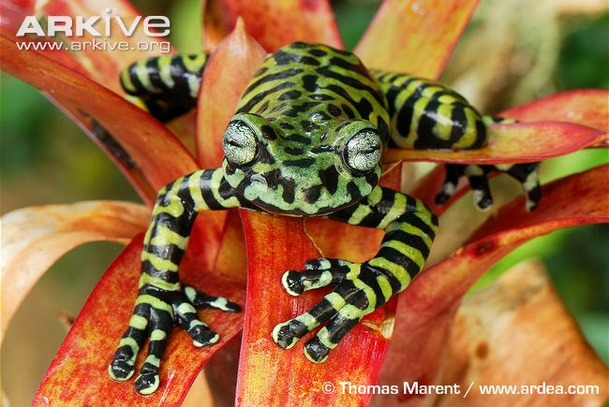
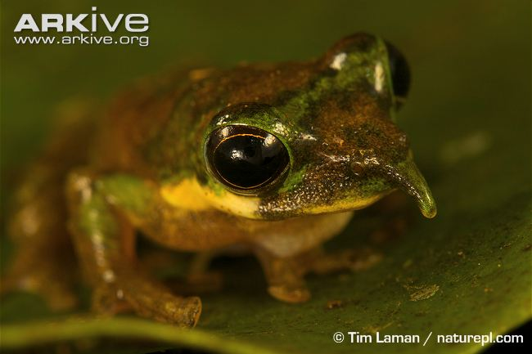
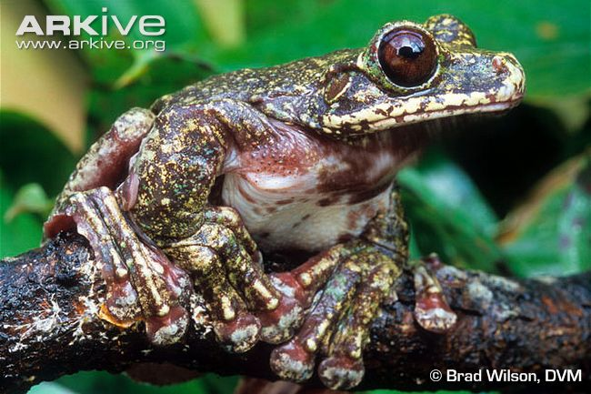
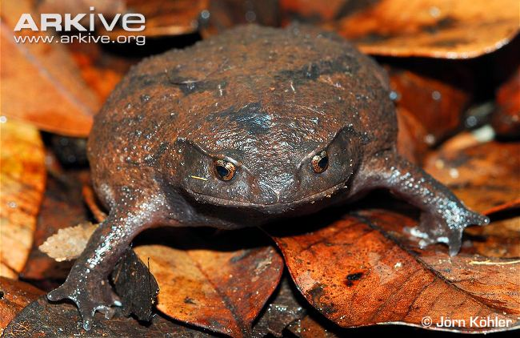
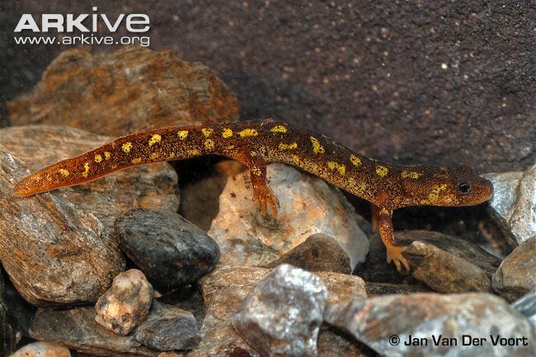
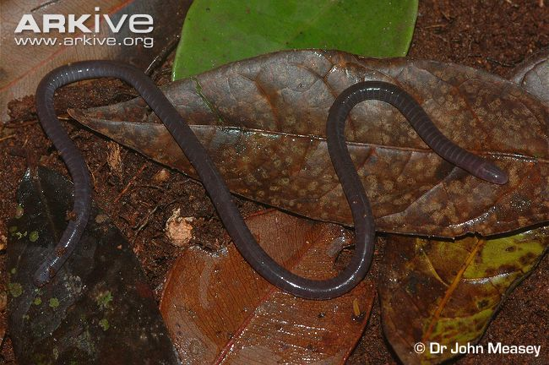
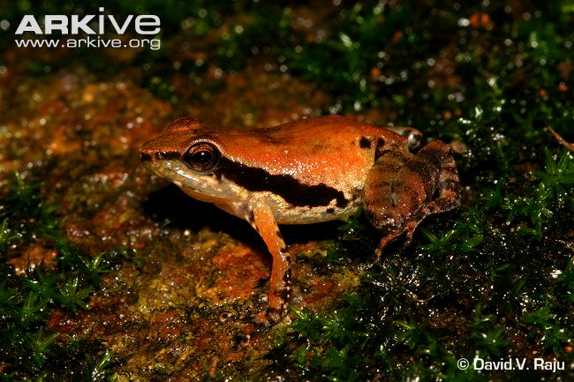
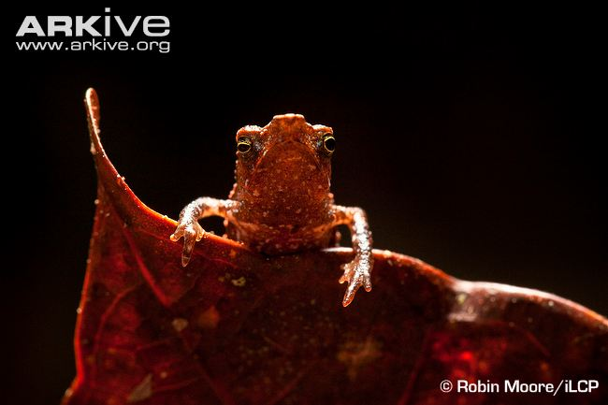
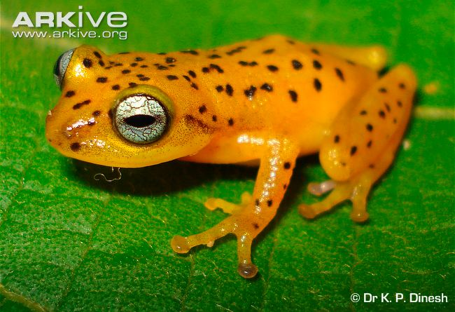
1.
Tiger’s treefrog
2.
Long-nosed treefrog
3.
Rabb’s fringe-limbed treefrog
4.
Microhylid frog
5.
Montseny Brook newt
6.
Sagalla caecilian
7.
Thampi’s torrent frog
8.
Mr Burns beaked toad
9.
Raorchestes

Slide 10
Worksheet A
Extension: Make Your Own Classification Key
You have been given pictures of 6 newly discovered species.
Look carefully at each of the pictures and write down a list of features that make each species different from each other.
If you need help, look up the species on ARKive (www.arkive.org) and read the species profile to find out more information about the species.
Think about things that will help you separate different groups of animals, e.g. Does it have fur? Can it fly? Does it have a tail? Does is lay eggs? Does it live in water? Remember – each question you ask should have a yes or no answer!
Using the features on your list, try and make your own classification key that would help somebody who has never seen the animals in your pictures to identify them.
Once you have made your key, you need to test whether or not it works! If you have worksheet A, swap with someone with worksheet B. If you have worksheet B, swap with someone with worksheet A.

Slide 11
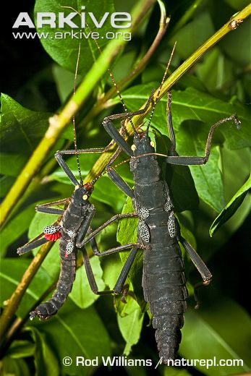
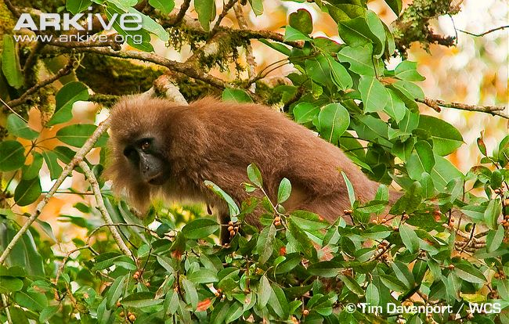
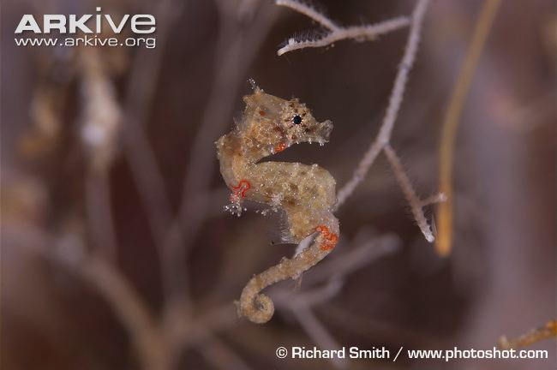
Worksheet A – List the features of each species to help you think of questions for your classification key
Kipunji (Rungwecebus kipunji)
http://www.arkive.org/kipunji/rungwecebus-kipunji/
Golden eyed stick insect
(Peruphasma schultei)
http://www.arkive.org/golden-eyed-stick-insect/peruphasma-schultei/
Satomi's pygmy seahorse (Hippocampus satomiae)
http://www.arkive.org/satomis-pygmy-seahorse/hippocampus-satomiae/

Slide 12
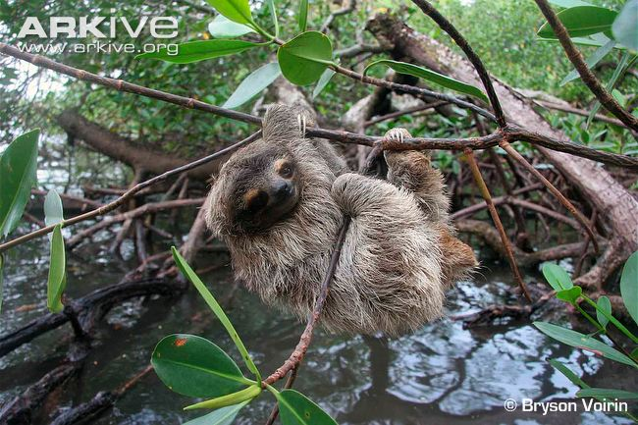
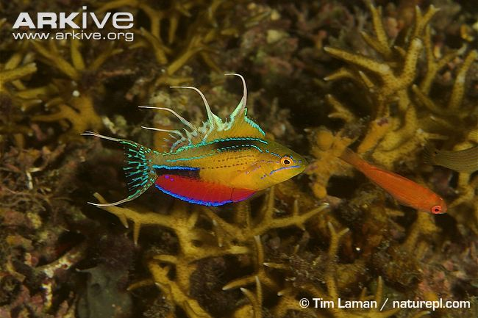
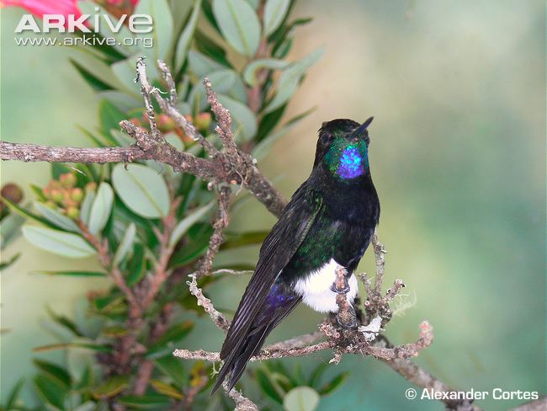
Worksheet A – List the features of each species to help you think of questions for your classification key
Pygmy three-toed sloth (Bradypus pygmaeus)
http://www.arkive.org/pygmy-three-toed-sloth/bradypus-pygmaeus/
Flasher wrasse (Paracheilinus nursalim)
http://www.arkive.org/flasher-wrasse/paracheilinus-nursalim/
Gorgeted puffleg (Eriocnemis isabellae)
http://www.arkive.org/gorgeted-puffleg/eriocnemis-isabellae/

Slide 13
Worksheet A – Draw your classification key below

Slide 14
Worksheet A – Swap this with somebody with worksheet B to test your classification key will help them work out the name of each species in the pictures
1.
2.
3.
4.
5.
6.

